Slide 1

“Picca”
Mid year Seminar
Btech 451
- Chunkz P.

Slide 2
Picca Introduction
An image processing application for Android Nexus S
What are the main functionalities of Picca?
Image enhancement
Image restoration
Images are restored/enhanced by the use of filters
Picca will solve problems such as:
digital noise, bad exposure, blurry images, and configure colour and contrast
“Digital noise”: “grain” that we notice in images
Reasons: high ISO levels and rarely a problem in daylight (dependent on the camera)
Home screen search function

Slide 3
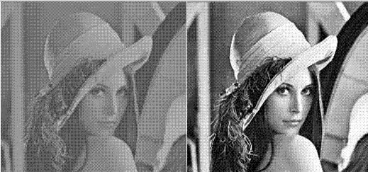
What are my goals?
To gain skills and knowledge of designing an Android application
Solve any type of image enhancement and restoration issues
To provide the user with variety of filters to choose from
To successfully complete the project according to the requirements of my supervisor

Slide 4
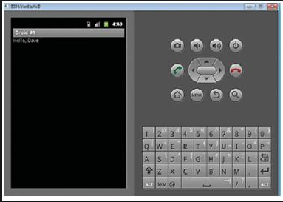
Work done so far
Research on Android programming and architecture
Android tutorials
Developed Balsamiq Mock-ups
Filter selection and research: recommended by Patrice
Picca home screen developed and tested on emulator
Mid year report
Website

Slide 5
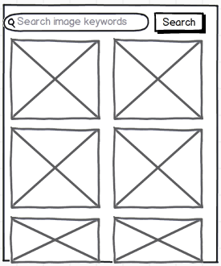
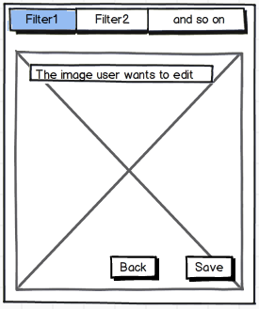
Initial Mock-ups

Slide 6
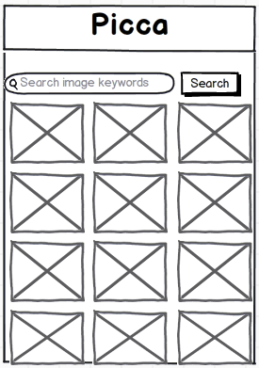
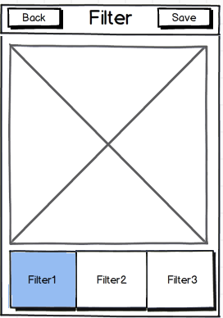
Revised Mock ups

Slide 7
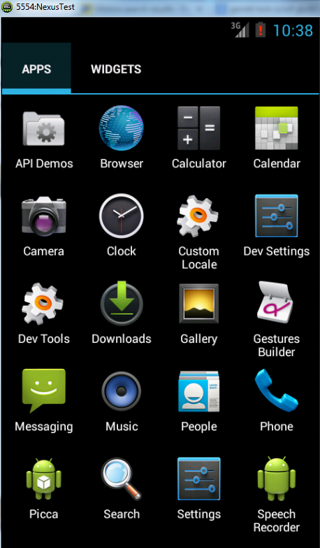
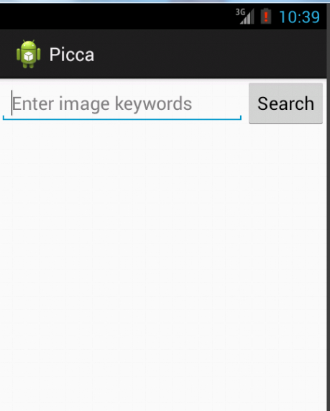
Home screen tested on Emulator

Slide 8
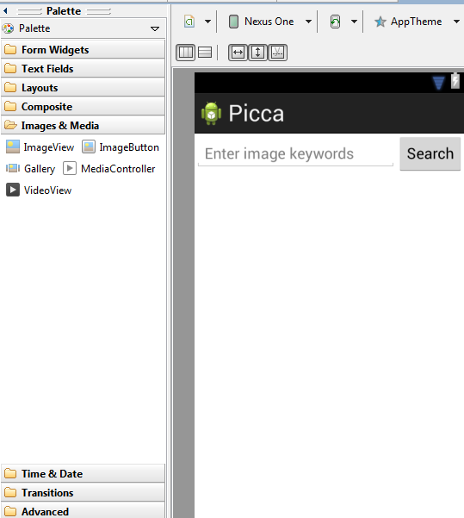
Picca Programming work
Graphical Layout Tool
MainActivity class:
OnCreate()
onCreateOptionsMenu()
sendMessage():
do something when clicked
An Intent binds two activities
findViewById() to get the EditText element

Slide 9
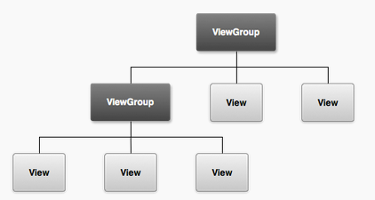
Picca programming work
AndroidManifest.xml: describes the fundamental characteristics of the app and defines each of its components. <uses-sdk android:minSdkVersion="8" android:targetSdkVersion="17" />
The graphical user interface for an Android app is built using a hierarchy of View and ViewGroup objects.
Created LinearLayout using activity_main.xml file. Added TextField, Search button and String resources separately.
Starting another activity to respond to the Search button. Not yet completed.

Slide 10
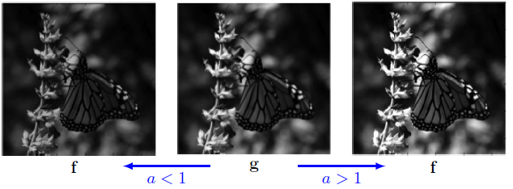
Filters: Colour adjustment or linear mapping
Adjustment by applying a constant gain a and offset, or bias b to pixel values of an image g to form the new image f : f(x; y) = ag(x; y) + b
“stretching" pixel-wise grey values (intensities) to span a larger range of values. Improving visual contrast of an image.
Main reasons for acquiring low-contrast images:
Poor illumination conditions
Poor image sensor dynamics
Incorrect setting of the lens

Slide 11
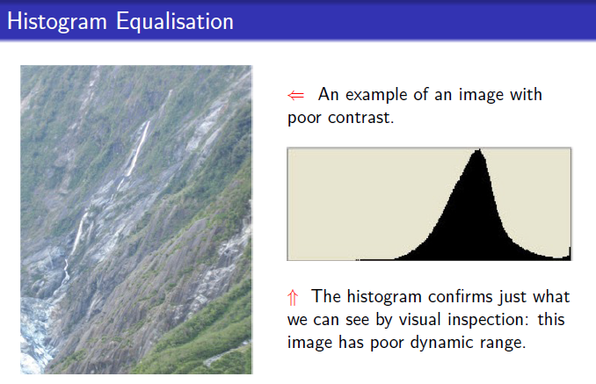
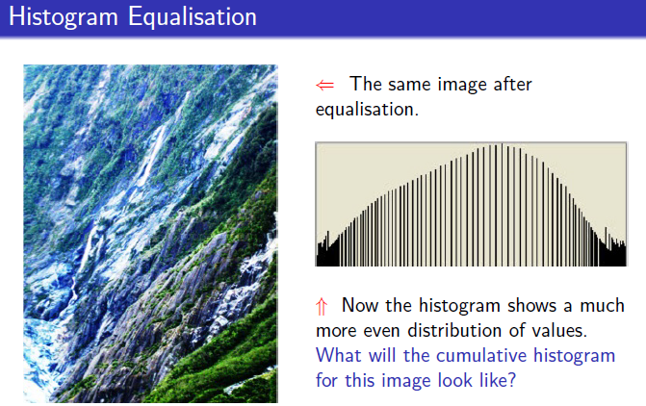
Filters: Image equalisation
A non-linear mapping of pixel intensity to distribute output intensity evenly
increases the dynamic range
Increases contrast
useful in images with both bright or both dark backgrounds and foregrounds
reveal details that would be otherwise hidden.

Slide 12
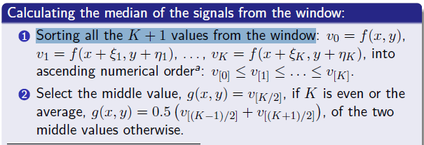
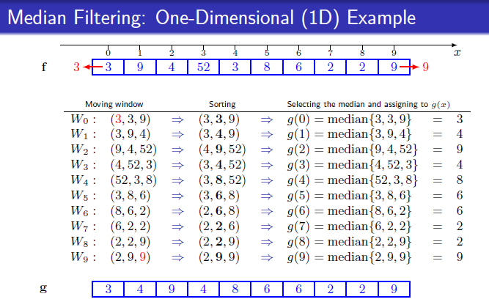
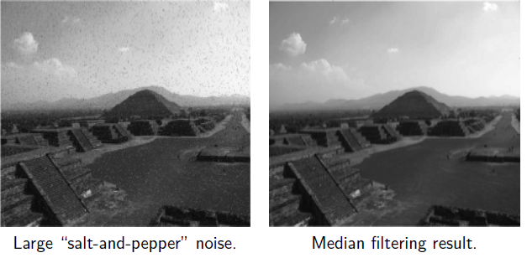
Filters: Median filtering
Effective nonlinear filtering
to remove the “salt and pepper” image noise while preserving edges
Boundary values problem:
Avoid processing the boundaries
Fetching entries from other places in the signal
Shrinking the window near the boundaries

Slide 13
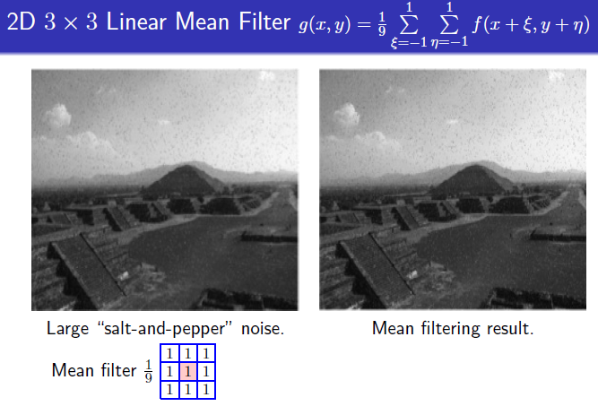
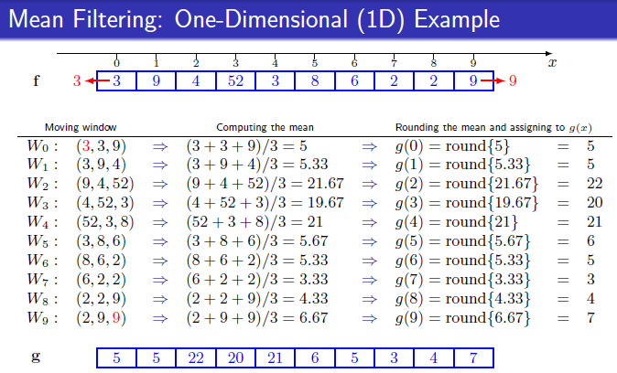
Filters: Mean filter
“Smoothing” of images by reducing the variation of intensities between the neighbouring pixels

Slide 14
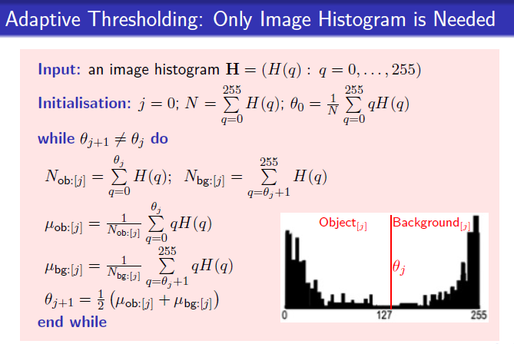
Filters: Adaptive thresholding
Process of separating a background from an object
Successive refinement of the estimated peak positions

Slide 15
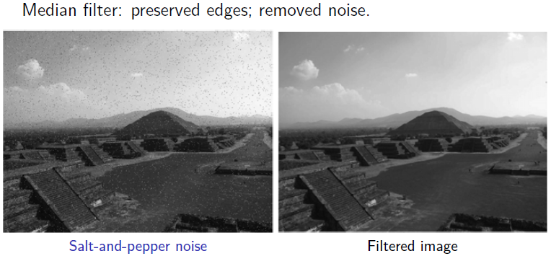
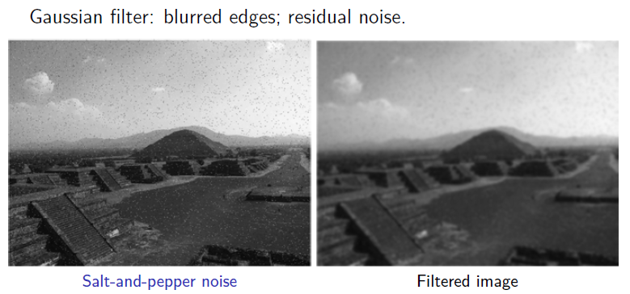
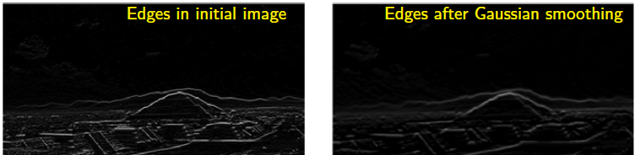
Filters: Gaussian Filter
To blur images and remove noise and fine detail
One-dimensional Gaussian function (zero mean)
Efficient for image smoothing to more accurate approximation of derivatives in edge detection.

Slide 16
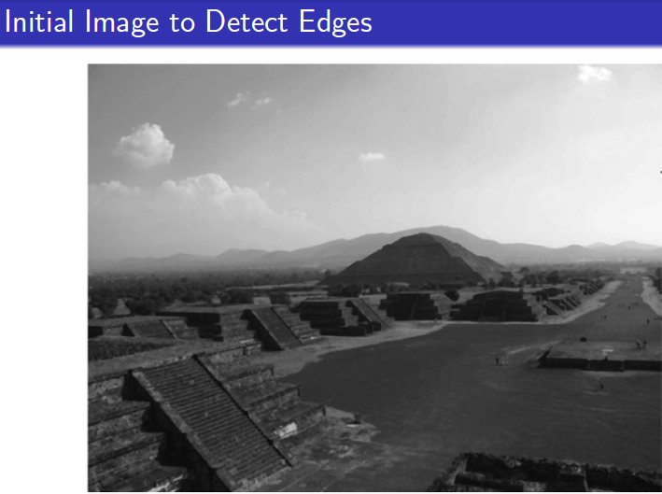
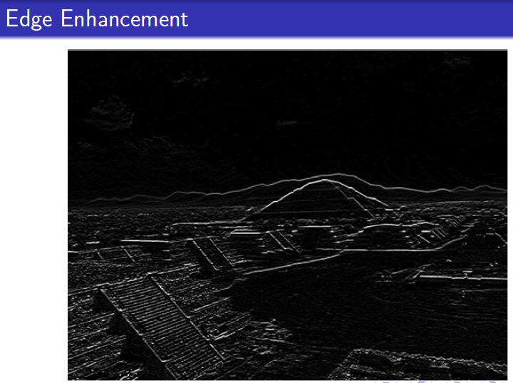
Filters: Edge detection
One of major applications of image filtering
An edge refers to:
Locations of sudden grey level / colour changes.
Transition between objects or between an object and background
Locations that attract visual attention

Slide 17
The End
Any Questions?

